Slide 1
Ocean Liner Tycoon
Lycia Stenson

Slide 2
What is Ocean Liner Tycoon?

Slide 3
What is Ocean Liner Tycoon?
‘Ocean Liner Tycoon’ is a mobile tycoon game.
Tycoons are a very popular genre in the mobile market.
Players build a fleet of ocean liners, with the ability to customise the design and structure of each ship.
Players also manage their fleet, taking passengers on voyages.

Slide 4
The Gameplay Loop
Design Ship
Voyages
Profit
Upgrades
Players design a ship for their ocean liner fleet, customising the shape of the hull and superstructure, and designing interior spaces.
Ships automatically make voyages viewable on a world map. Up close the player can micromanage and control a specific ship.
The player profits in-game currency from voyages, the amount depending on how much the passengers enjoyed their time and the facilities.
The in-game currency can be spent to upgrade ship technology and entertainment, and to design and build new ships.

Slide 5
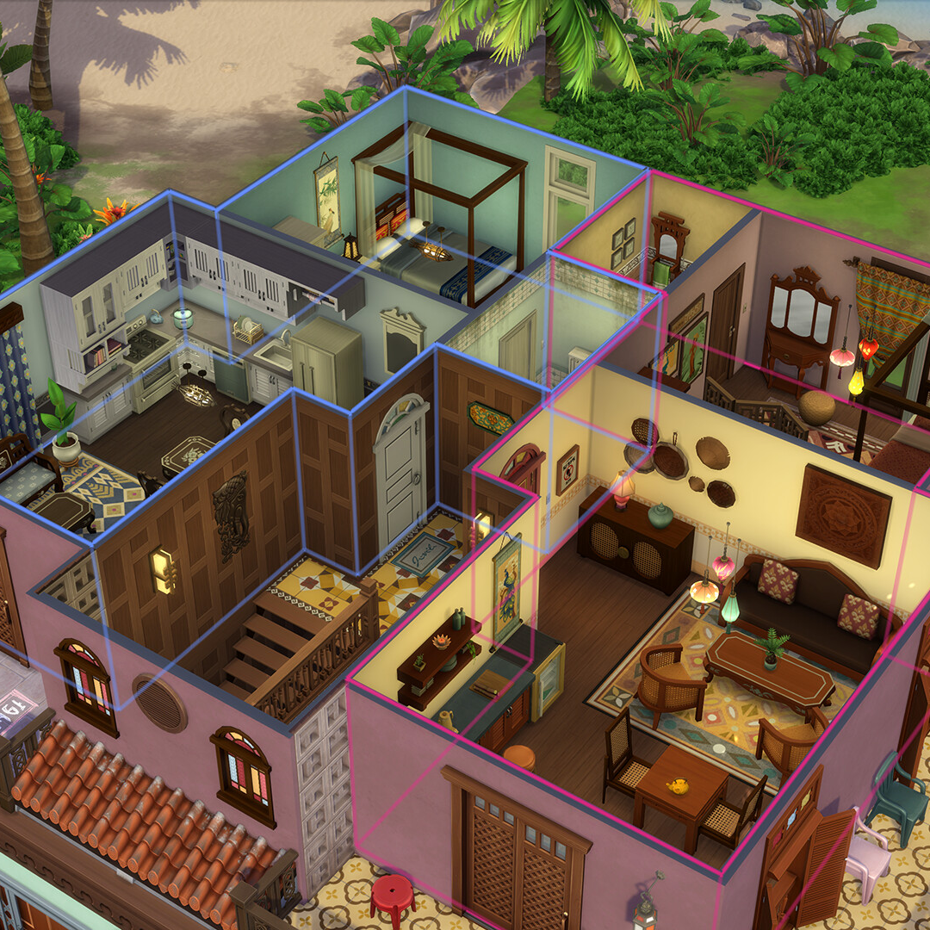
Cutaway View
During both the ship building and micromanage stages of the game, when the player zooms in the perspective closer, the selected deck will be displayed with a cutaway effect like that of The Sims.
Notes:
Electronic Arts, The Sims™ For Rent Expansion Pack. Available at: https://www.ea.com/en-gb/games/the-sims/news/for-rent-expansion-pack (Accessed 16th December 2024)

Slide 6

Target Audience
Maritime Enthusiasts
Wider Audience
The primary target audience is enthusiasts of maritime history.
The game will also appeal to a wider audience due to the continuing presence of the Titanic in popular culture.
Notes:
Paramount Pictures and 20th Century Fox, Titanic (1997) 2012 Re-release poster. Available at: https://www.imdb.com/title/tt0120338/mediaviewer/rm901821184/ (Accessed 16th December)

Slide 7
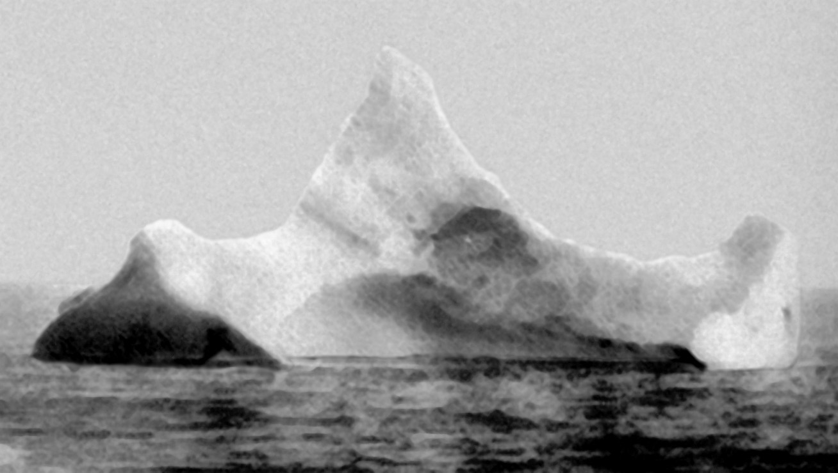
‘The Natural Predator of the Ocean Liner’

Slide 8
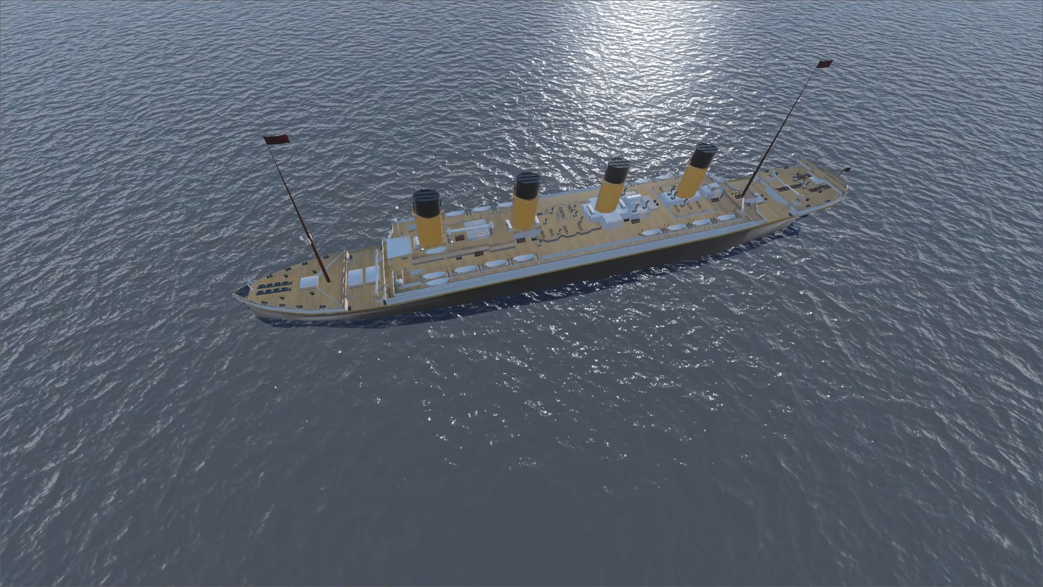
Graphics and Mechanics are not representative of final product. Early demonstration only.
Notes:
Millernathan471, RMS Olympic. Available at: https://sketchfab.com/3d-models/rms-olympic-6182116010494e4a954821ad39af73e0 (Accessed November 21st 2024)

Slide 9


‘Our friend Mike Brady from Oceanliner Designs’
Mike Brady runs the popular YouTube channel Oceanliner Designs. Sponsoring his content will allow the game to reach a large audience of maritime enthusiasts.
Notes:
Michael C. Brady. Available at: https://www.grandvoyagegame.com/our-team (Accessed 15th December 2024)
Oceanliner Designs, Oceanliner Designs logo. Available at: https://www.youtube.com/@OceanlinerDesigns

Slide 10

Maximising Engagement
Ocean Liner Tycoon
Your ship ‘RMS Oceanic’ has struck an iceberg! Command the evacuation and rescue operation!
now
Ocean Liner Tycoon
Your ship ‘SS Adriatic’ has reached New York! Check out your profit!
30m ago
To maximise player engagement and retention, push notifications will remind the player.
Notes:
Stefan Schweihofer, Color Acrylic Paint Art. Available at: https://pixabay.com/photos/color-acrylic-paint-art-painting-4158152/ (Accessed 16th December 2024)

Slide 11
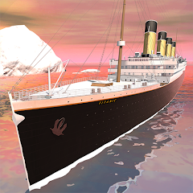

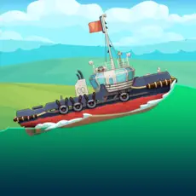
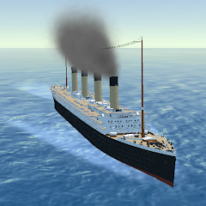
Competitors What’s different about ‘Ocean Liner Tycoon’?
Idle Titanic Tycoon: Ship Game
Stormworks: Build and Rescue
The player captains the Titanic. As a tycoon game it shares some similarities with our game but lacks ship building mechanics.
Players build and pilot vehicles including ships. The game is available only on desktop and does not contain a passenger tycoon aspect, instead focusing on a disaster relief career mode.
Ship Simulator: Boat Game
Ocean Liner Simulator
The player builds a nuclear power plant, transporting equipment and resources via boats.
The player controls four famous ocean liners navigating in and out of ports. The game lacks the ship building aspect and the tycoon business aspects present in ‘Ocean Liner Tycoon’
Notes:
IsCool Entertainment, Idle Titanic Tycoon; Ship Game. Available at: https://play.google.com/store/apps/details?id=com.neonplay.casualidletitanictycoon (Accessed 16th December 2024)
Azur Interactive Games Limited, Ship Simulator: Boat Game. Available at: https://apps.apple.com/gb/app/ship-simulator-boat-game/id6451137140 (Accessed 16th December 2024)
Geometa, Stormworks: Build and Rescue. Available at: https://geometa.co.uk/stormworks (Accessed 16th December 2024)
Aleksander Turkin, Ocean Liner Simulator. Available at: https://play.google.com/store/apps/details?id=com.TAV.OceanLiner (Accessed 16th December 2024)

Slide 12
The Team
Lycia Stenson
Todd Clark
Ophelia O’Melia
Project Lead
Lead Programmer
Lead Designer
Lead Artist
Lisa Curtis
Melissa Curtis
Technical Designer
Programmer
Prop & Set Artist

Slide 13
Development Timeline
Start development
Closed Beta
Release
The team will get to work building the first prototype of the game.
Running a closed beta with members of the community built over development.
Releasing on Google Play and iOS App Store
Feb
2025
May
2025
Sept
2025
Nov
2025
Jan
2026
Working prototype
Marketing
Demonstrating core gameplay mechanics such as ship building and voyages.
Begin sharing progress on social media.
Ramp up marketing of the game. Advertising on social media and sponsored content.

Slide 14
Cost Overview
Personnel
Hardware
Office
Marketing
Programmers, designers, and artists building the game.
Development PCs and smartphones for testing.
Office space will enable better communication and work between team members.
Social media advertising, such as YouTube, TikTok, and Sponsorships
Notes:
References can be found in notes section of Cost Breakdown

Slide 15


Software Costs?
Godot
Blender
Godot is a Free and Open Source game engine, meaning zero royalties.
Like Godot, Blender is a Free and Open Source 3D modelling software, meaning zero royalties.
Notes:
Godot Foundation, Vertical Logo Colored Light. Available at: https://godotengine.org/press/ (Accessed 17th December 2024)
Blender Foundation, Blender Logo Square Icon. Available at: https://www.blender.org/about/logo/ (Accessed 17th December 2024)

Slide 16
Cost Breakdown
Expense | Count | Single | Yearly | Monthly |  |  |  |  | Total
Personnel | 5 | - | £26,000.00 | £2166.67 |  |  |  |  | £130,000
Dell XPS | 5 | £1,499.00 | - | - |  |  |  |  | £7,495.00
Samsung A15 | 5 | £129.00 | - | - |  |  |  |  | £645.00
Graphics Tablet | 2 | £69.99 | - | - |  |  |  |  | £139.98
Office space | 1 | - | £5,832 | £486 |  |  |  |  | £5,832.00
Social Media Advertising
Creator Sponsorship | 3 | £30 CPM * ~170k views = ~£5,100 | - | - |  |  |  |  | ~£15,300
Total | - | £6796.99 |  |  |  |  |  |  | £159,411.98
Notes:
Dell Technologies, XPS Desktop. Available at: https://www.dell.com/en-uk/shop/desktop-computers/xps-desktop/spd/xps-8960-desktop/bdx89632nkm (Accessed 18th December 2024)
Samsung Electronics, Samsung Galaxy A15. Available at: https://www.samsung.com/uk/smartphones/galaxy-a/galaxy-a15-blue-black-128gb-sm-a155fzkdeub/ (Accessed 18th December 2024)
Wacom, Wacom Intuos. Available at: https://www.currys.co.uk/products/wacom-intuos-ctl4100kn-5-graphics-tablet-10178473.html (Accessed 18th December 2024)
Office Freedom, Southgate House Southgate Street, Gloucester. Available at: https://www.rightmove.co.uk/properties/155494793 (Accessed 18th December 2024)
Creator sponsorship ~170k views averaged from 12 most recent videos by Oceanliner Designs
Oceanliner Designs, Oceanliner Designs YouTube channel. Available at: https://www.youtube.com/@OceanlinerDesigns/videos (Accessed 18th December 2024)

Slide 17
Any Questions?
Ocean Liner Tycoon
lycia@oceanlinertycoon.com
oceanlinertycoon.com
Relevant Harvard references can be found in the notes section of each slide
Notes:
Slidesgo, Reconstruction Era and the Gilded Age - History - 11th Grade. Available at: https://slidesgo.com/theme/reconstruction-era-and-the-gilded-age-history-11th-grade (Accessed December 12th 2024)
Slidesgo, Reconstruction Era and the Gilded Age - History - 11th Grade Infographics. Available at: https://slidesgo.com/theme/reconstruction-era-and-the-gilded-age-history-11th-grade-infographics (Accessed December 17th 2024)

Slide 18
The Gameplay Loop
Design a ship
Voyages
Spend profit
Players design a ship for their ocean liner fleet, customising the shape and designing the interior spaces.
Ships automatically and continuously make voyages, and can be viewed on a world map. Interacting with the ship to manage the voyage more directly.
Spend the profit of the voyage to upgrade the ship, and eventually build bigger ships

Slide 19
- Whoa! -
This can be the part of the presentation where you introduce yourself, write your email…

Slide 20
01
Introduction
You can enter a subtitle here if you need it

Slide 21
—Someone Famous
“This is a quote, words full of wisdom that someone important said and can make the reader get inspired”

Slide 22
Finances
Aspects | Reconstruction Era | Gilded Age
Time period | 1865-1877 | 1877-1900
Post-war conditions | Devastation from the Civil War, Southern Reconstruction | Rapid industrialization and economic growth
Focus | Rebuilding and integrating Southern states | Economic expansion, technological advancements, and urbanization
Civil rights | Emphasis on African American civil rights | Expansion of civil rights issues, including labor and women's rights

Slide 23
Where are the Software Costs?
Godot
Thaddeus Stevens
You can write the description here
You can write the description here
You can write the description here
You can write the description here
You can write the description here
You can write the description here
You can write the description here
You can write the description here
You can write the description here
You can write the description here
You can write the description here
You can write the description here

Slide 24
98,300,000
Big numbers catch your audience’s attention

Slide 25
9h 55m 23s
333,000
386,000 km
Jupiter's rotation period
The Sun’s mass compared to Earth’s
Distance between Earth and the Moon

Slide 26
Workforce distribution in the Gilded Age
25%
50%
75%
Industrial workers
Agrarian workers
Service sector
Mercury is the closest planet to the Sun and the smallest of them all
Despite being red, Mars is actually a cold place. It’s full of iron oxide dust
Venus has a beautiful name and is the second planet from the Sun

Slide 27
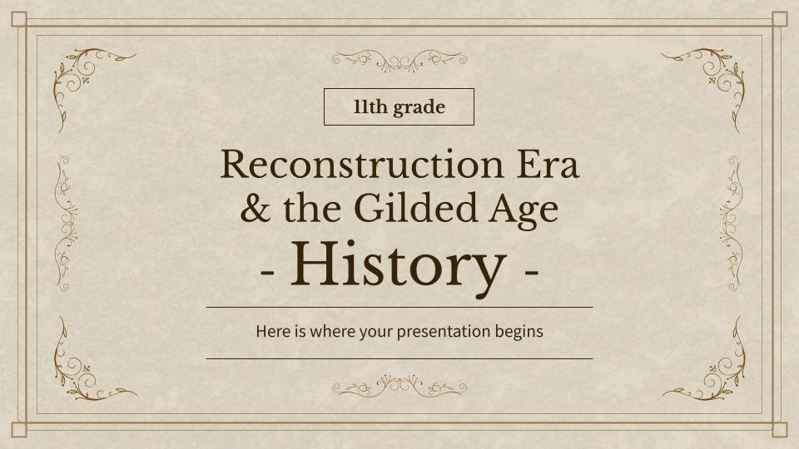
Computer mockup
You can replace the image on the screen with your own work. Just right-click on it and select “Replace image”

Slide 28
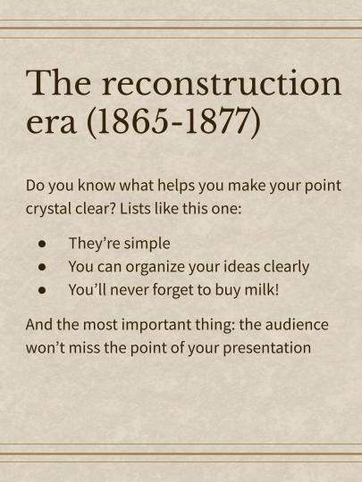
Tablet mockup
You can replace the image on the screen with your own work. Just right-click on it and select “Replace image”

Slide 29
The Gilded Age: 1870-1900
Industrialization & urbanization
Ranching, mining & farming
Reconstruction & rise of Jim Crow segregation

Slide 30
The key aspects
Reconstruction Era
Gilded Age
Rebuilding states
Limited economic
Economic growth
Economic expansion
Neptune is far away from Earth
Mercury is the closest planet to the Sun
Venus is the second planet from the Sun
Jupiter is the biggest planet of them all

Slide 31
Reconstruction amendments
Amendment | Description | Ratification Date
13th Amendment | Abolished slavery and involuntary servitude in the United States, except as punishment for a crime | December 6, 1865
14th Amendment | Granted citizenship to all persons born or naturalized in the United States, including former slaves, and guaranteed equal protection under the law | July 9, 1868
15th Amendment | Prohibited the denial of voting rights based on race, color, or previous condition of servitude. It aimed to protect the voting rights of African American men | February 3, 1870

Slide 32
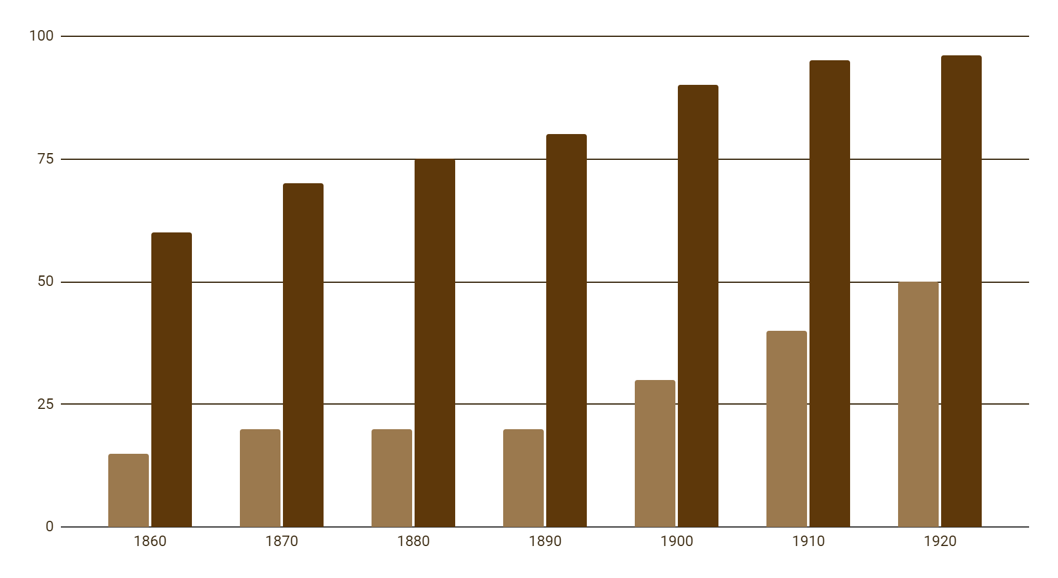
American become urbanized
Urban
Rural
Venus is the second planet from the Sun
Saturn is a gas giant with rings
Follow the link in the graph to modify its data and then paste the new one here. For more info, click here

Slide 33
Exercise 1: Answer this questions
What was the purpose of the Freedmen's Bureau?
You can answer here
What characterized the Gilded Age?
You can answer here
What did the Sherman Antitrust Act aim to do?
You can answer here

Slide 34
Exercise 2: True or False
Instructions: Mark the statement below by filling in the True (T) box if it is true, False (F) if you feel the statement is not correct
No. | Sentences | True | False
1 | The 13th Amendment to the United States Constitution abolished slavery | … | …
2 | The Panic of 1873 led to a severe economic depression in the United States | … | …
3 | The Reconstruction Era followed the American Civil War | … | …

Slide 35
Exercise 3: Multiple choice
Instructions: Choose the most appropriate answer from the provided options (a, b, c, or d) by placing a square shape to the correct answer
Which period immediately followed the Reconstruction Era?
A | Progressive Era | C | Colonial Era
B | Gilded Age | D | Civil Rights Movement

Slide 36
Exercise 4: Fill in the blank
Instructions: Identify the missing word(s) that complete(s) the sentence. Write your answer in the space provided
1 | The Reconstruction Era followed the | …
2 | The 13th Amendment | … | slavery
3 | The Gilded Age was characterized by political | … | and social inequality
4 | Plessy v. Ferguson upheld racial segregation under the | … | doctrine

Slide 37

Our team
Sofia Hill
Kaliyah Harris
You can speak a bit about this person here
You can speak a bit about this person here

Slide 38
Alternative resources
Here’s an assortment of alternative resources whose style fits the one of this template:
Vectors
Realistic silver frame template
Golden frame template

Slide 39
Resources
Did you like the resources on this template? Get them for free at our other websites:
Vectors
Barbershop invoice template with grainy retro texture
Realistic golden frame design
Photos
Festive independence day composition
Facade beautiful historic building
Pirate artifacts arrangement still life
Portrait volunteers who organized donations charity

Slide 40
Contents of this template
You can delete this slide when you’re done editing the presentation
Fonts | To view this template correctly in PowerPoint, download and install the fonts we used
Used and alternative resources | An assortment of graphic resources that are suitable for use in this presentation
Thanks slide | You must keep it so that proper credits for our design are given
Colors | All the colors used in this presentation
Icons and Infographic resources | These can be used in the template, and their size and color can be edited
Editable presentation theme | You can edit the master slides easily. For more info, click here
For more info: SLIDESGO | BLOG | FAQs
You can visit our sister projects: FREEPIK | FLATICON | STORYSET | WEPIK | VIDEVO

